Slide 1

[Samsung PRISM] Weekly Review
AI/ML Based Network Device Software upgrade in SDN Controlled Network
Team
College Professor(s): Dr.P. PRAKASAM / prakasam.p@vit.ac.in
Students:
SAKSHI A. RAGHAVAN / sakshiraghavan.a2020@vitstudent.ac.in
JAYA SRI KRISHNA.S / jayasri.krishna2020@vitstudent.ac.in
JANARTHANAN.P.M / janarthanan.pm2020@vitstudent.ac.in
Department: ECE

Slide 2

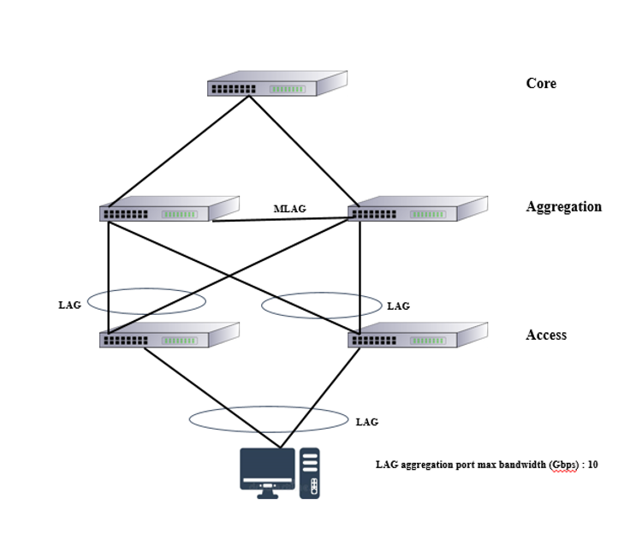
CSW23 | AI/ML Based Network Device Software upgrade in SDN Controlled Network
ARCHITECTURE
Srevatsa, Director
Vanraj, Manager
Notes:
-

Slide 3
Literature survey and study
Major Observations / Conclusions:
(provide details about your findings, experimental opinion – Use separate slide if necessary)
Xuyuntao Zhang, Shuaiyong Li, Cha Zhang,“Short-Term Prediction of SDN Network Traffic Based on CEEMDAN and Mixed Kernel Least Squares Support Vector Machine”, 2022 5th International Conference on Pattern Recognition and Artificial Intelligence (PRAI), ISBN 978-1-6654-9916-3, 978-1-6654-9915-6, (http://surl.li/dmgcg)
PUBLICATION YEAR: 2022
The main contribution of the paper includes:
The paper proposes a combined prediction model combining decomposition algorithm, hybrid kernel least squares support vector machine, and optimization algorithm, considering the characteristics of network traffic such as nonlinearity and non-smoothness.
Firstly, the original data series is decomposed into a series of Intrinsic Mode Function (IMF) using the Complete Ensemble Empirical Mode Decomposition with Adaptive Noise (CEEMDAN) to smooth the series.
Then, the fuzzy C-mean algorithm (FCM) is used to classify each component into three classes based on its amplitude-frequency characteristics.
Next, based on the different characteristics of the kernel functions, least-squares support vector machine (LSSVM) prediction models with corresponding kernel functions are constructed for each class of components, and the parameters of each model are optimized using the artificial bee colony algorithm (ABC). Finally, the prediction results of each component are cumulatively reconstructed to obtain the final prediction results. Through experimental comparison, the prediction accuracy of the proposed model (CEEMDAN-FCM-LSSVM-ABC) is better than that of CEEMDAN-LSSVM, EMD-LSSVM, LSSVM, and other models.

Slide 4
Literature survey and study
Major Observations / Conclusions:
(provide details about your findings, experimental opinion – Use separate slide if necessary)
Richard Etengu, Saw ChinTan, Teong Che Chuah, Jaime Galan-Jimenez, “Deep Learning-Assisted Traffic Prediction in Hybrid SDN/OSPF Backbone Networks”, NOMS 2022-2022 IEEE/IFIP Network Operations and Management Symposium, ISBN: 978-1-6654-0601-7, (http://surl.li/dmgdu )
PUBLICATION YEAR: 2022
The paper’s gist:
Owing to the linear nature of network design, generally typified by manual control plane forwarding design, current frameworks are incapable of performing accurate traffic prediction over datasets in modern non-recurrent large-sized networks.
To address this issue, deep learning (DL) methods have recently been proposed as a possible solution. But, deciding the most appropriate DL models to be employed for accurate TM prediction is still a challenge.
This paper proposes an improved DL framework that utilizes different dimensionality feature reduction techniques to perform short-term TM prediction in SDN networks.
The two dimensionality reduction techniques required to perform feature reduction for the DL model are correlation component analysis (CCA) and principal component analysis (PCA). Investigational results show that the proposed method can achieve more accurate forecast of link traffic in comparison to the traditional baseline machine learning frameworks.

Slide 5
Literature survey and study
Major Observations / Conclusions:
(provide details about your findings, experimental opinion – Use separate slide if necessary)
Abdullah Baz, “Bayesian Machine Learning Algorithm for Flow Prediction in SDN Switches” 2018 1st International Conference on Computer Applications & Information Security (ICCAIS): ISBN: 978-1-5386-4427-0
(http://surl.li/dmgfa)
The paper’s gist:
Segregation of data and control plans impose latency and overheads to SDN-based networks as a Networking Function Device (NFD aka Switch) needs to consult the controller how to handle each traffic.
In order to overcome such shortcoming of SDN, this paper makes use of the Bayesian Machine Learning (BML) to allow switches to infer the underlying stochastic process by which controller classifies packets into flows.
Based on this inference a switch can assign those packets whose flows are not given previously by the controller to the most appropriate flow.
Extensive simulation conducted to assess the performance of the proposed algorithm highlights its advantages compared to the standard mechanism defined in the-state-of-the-art SDN implementation.

Slide 6
Literature survey and study
Major Observations / Conclusions:
(provide details about your findings, experimental opinion – Use separate slide if necessary)
L. Huang, Y. Wang, M. Ye, H. Qiu, X. Deng, X. Xue, “Intelligent routing method based on Dueling DQN reinforcement learning and network traffic state prediction in SDN”, In: Wireless Networks. (Wireless Networks, 2022), ISSN: 15728196, (https://rb.gy/n7qp1w)
The paper’s gist:
The traditional routing method makes use of limited information on the network links to make routing decisions, which makes it difficult to adapt to the dynamic and complex network and adjust the router’s forward strategy.
To address these issues, this paper proposes an intelligent routing method based on the Software Defined Network (SDN), Dueling DQN (a Deep Reinforcement Learning algorithm) and network traffic state prediction.
First, the global network awareness information is obtained with the SDN network measurement mechanism, which is converted into a traffic matrix consisting of multiple network link status information such as bandwidth and delay, etc. Then, the optimal forwarding route under the current network state is generated by predicting the network traffic matrix and the Dueling DQN.
The experimental results show that: (1) compared with the traditional Dijkstra and OSPF routing methods, the proposed method significantly improves the network throughput and effectively reduces the network delay and packet loss rate; (2) comparing with the reinforcement learning algorithms DDPG and PPO, the proposed approach achieves a faster convergence state, which improves the efficiency of network routing.

Slide 7
Literature survey and study
Major Observations / Conclusions:
(provide details about your findings, experimental opinion – Use separate slide if necessary)
Sowmya Sanagavarapu, Sashank Sridhar, “SDPredictNet-A Topology based SDN Neural Routing Framework with Traffic Prediction Analysis”, Computing and Communication Workshop and Conference (CCWC), 2021 IEEE 11th Annual. :0264-0272 Jan, 2021, ISBN: 978-1-6654-1490-6, (https://rb.gy/tvfenr)
The paper’s gist:
The dynamic nature of traffic in these networks with multi-layer switches hinder the efficiency of SDN's performance in multi-cloud environments.
This paper proposes SDPredictNet, a Recurrent Neural Network framework deployed on the SDN Controller that can predict the traffic in the network and update flow tables of the higher layer switches to perform routing based on the perceived bottlenecks in the network.
SDPredictNet uses a Sequence-to-Sequence model that trains on the network data congestion to forecast the traffic in the SDN which is then modelled by an Artificial Neural Network to predict the path of the packets.
SDPredictNet has achieved a RMSE score of 0.07 and an accuracy of 99.88% for traffic estimation and subsequent path determination.
root-mean-square error (RMSE)

Slide 8
Literature survey and study
Major Observations / Conclusions:
(provide details about your findings, experimental opinion – Use separate slide if necessary)
A. Azzouni, G. Pujolle, “NeuTM: A neural network-based framework for traffic matrix prediction in SDN”, In: IEEE/IFIP Network Operations and Management Symposium: Cognitive Management in a Cyber World, NOMS 6 July 2018, ISBN: 9781538634165, (https://rb.gy/hilhap)
The paper’s gist:
This paper presents NeuTM, a framework for network Traffic Matrix (TM) prediction based on Long Short-Term Memory Recurrent Neural Networks (LSTM RNNs).
TM prediction is defined as the problem of estimating future network traffic matrix from the previous and achieved network traffic data. It is widely used in network planning, resource management and network security.
Long Short-Term Memory (LSTM) is a specific recurrent neural network (RNN) architecture that is well-suited to learn from data and classify or predict time series with time lags of unknown size.
LSTMs have been shown to model long range dependencies more accurately than conventional RNNs.
NeuTM is a LSTM RNN-based framework for predicting TM in large networks.
By validating our framework on real-world data from GEANT network, we show that our model converges quickly and gives state of the art TM prediction performance.

Slide 9
Literature survey and study
Major Observations / Conclusions:
(provide details about your findings, experimental opinion – Use separate slide if necessary)
Abel Sridharan, Bestoon Abdulmaged Othman, Surendra Kumar Shukla, Amrendra Tripathi, Anand Panday, Korakod Tongkachok, “The Emerging Role of Integrating Artificial Intelligence (Ai) in the Software Defined Network for Effective Traffic Prediction using Correlation Analysis”, Advance Computing and Innovative Technologies in Engineering (ICACITE), 2022 2nd International Conference on. :116-120 Apr, 2022, ISBN: 978-1-6654-3789-9, (https://rb.gy/1rug91)
The paper’s gist:
The TE supports in monitoring the network parameters including the utilisation of the bandwidth, however the critical element is to generate the data related to the utilisation, this also enable in monitoring and traffic analysis in an effective manner.
It also warns of congestion or problems in the system. There are two main ways that OFF flow meter data can be collected, the first is to collect the associated controls and then distribute the necessary equipment.
Nowadays, various technologies and monitoring technologies have been used to understand the overall performance of the device.
The application of AI techniques tends to offer better tacking the aggregation issue and provide better and flexible approach which can be used to manage the network traffic in an effective manner.

Slide 10
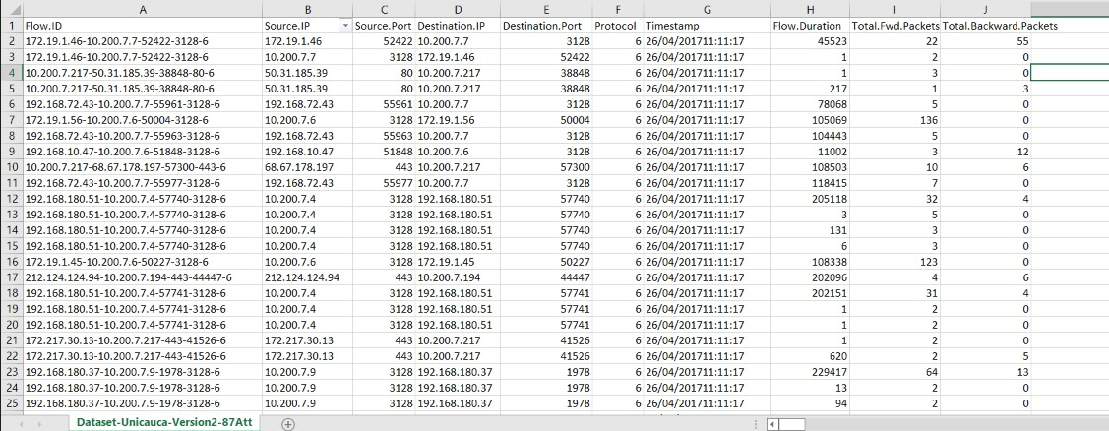
Literature survey and study
Major Observations / Conclusions:
(provide details about your findings, experimental opinion – Use separate slide if necessary)
DATASET FOUND:
Site:
https://www.kaggle.com/datasets/jsrojas/ip-network-traffic-flows-labeled-with-87-apps

Slide 11
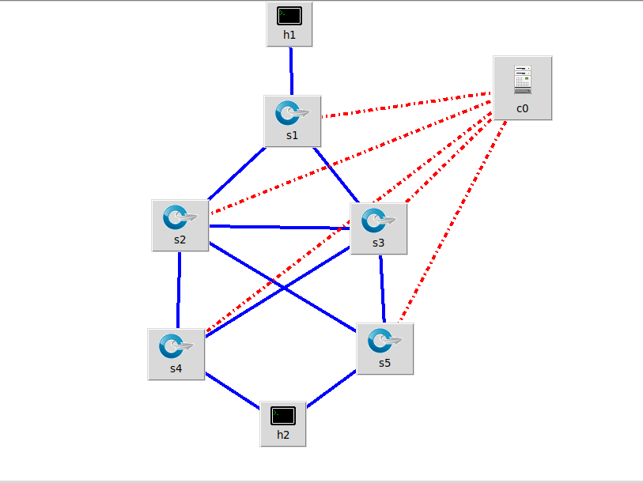
Queries
Challenges :
(Discuss in the form of bullets, what are the next action steps, any road blocks / bottlenecks)
Created topology in mininet:

Slide 12
Thank you

